Slide 1
Cost Estimator Project
Teams- Express & Adonis

Slide 2
Our Client
Instructors
Curt Carpenter
C&G Coatings
Dr. Ajay Bandi
Dr. Denise Case

Slide 3
Team Members (Express)
Santosh Sekhar Muchkur Bogarajula
Girish Guntuku
Yashwanth Reddy Bommineni

Slide 4
Team Members (Adonis)
Satya Sai Ram Vankina
Sai Sirisha Devineni
SaiCharan Gurudu
Vijay Tupakula

Slide 5
Introduction
A cost estimating app to quickly estimate and quote job costs.
This application has only one user i.e, Curt.
What is an estimate ?
A cost estimate is the approximation of the cost of a program, project, or operation. The cost estimate is the product of the cost estimating process. The cost estimate has a single total value and it comprises various components.
Sai Sirisha Devineni
Notes:
Source: https://en.wikipedia.org/wiki/Cost_estimate

Slide 6
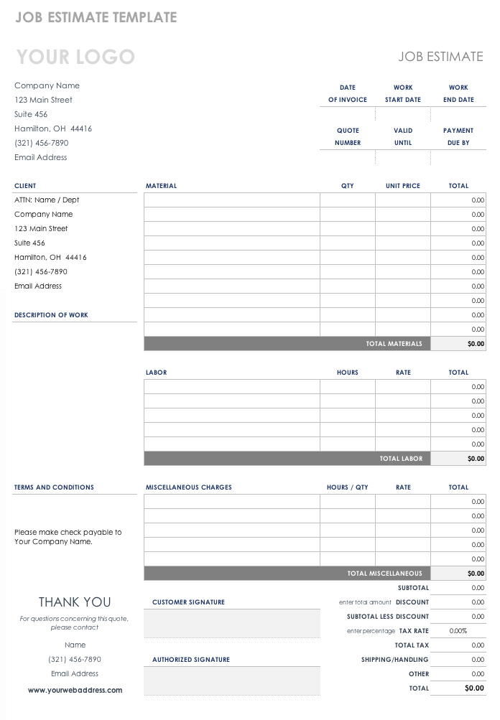
Introduction(Contd..)
A sample of manual estimate sheet
Sai Sirisha Devineni
Notes:
Source: https://www.smartsheet.com/job-work-estimate-templates

Slide 7
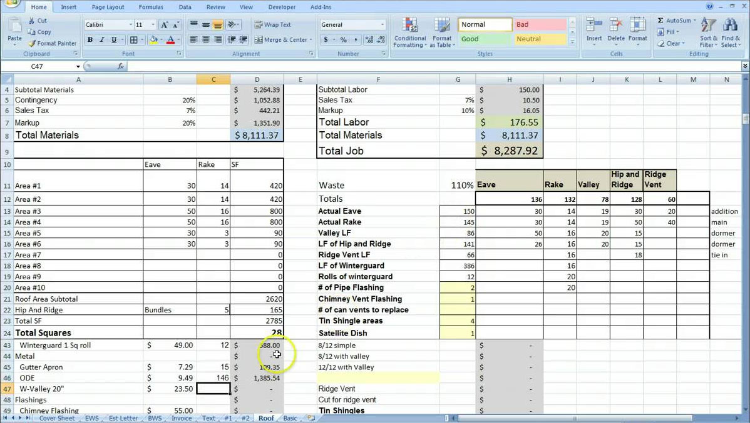
Introduction(Contd..)
Excel sheet estimate sheet
Sai Sirisha Devineni
Notes:
Source:https://golagoon.com/estimating-spreadsheet-template/excel-spreadsheets-help-trip-cost-estimator-spreadsheet-template-project-estimate/

Slide 8
Introduction(Contd..)
An estimate is calculated by summing up the various components.
Labor cost
Hotel cost
Vehicle cost
Food cost
Material cost
Miscellaneous costs
Sai Sirisha Devineni
Notes:
Source: https://www.smartsheet.com/job-work-estimate-templates

Slide 9
Introduction(Contd..)
A cost estimating app to quickly estimate and quote job costs.
It is a progressive web application in which a user can login and can perform CRUD(create, view, update and delete) operations on the estimates.
It is developed on the requirements given by the curt carpenter.
Sai Sirisha Devineni

Slide 10

Problem Statement
Creating and storing estimates manually is a tedious task.
Excel sheet estimates
Manual entry of each attribute in an estimate is difficult.
A user need to write a new and complete estimate every time even if there is a similar estimate completed previously.
Sai Sirisha Devineni

Slide 11


Proposed Solution
We have decided to help our client get rid off the problems seen previously by providing him a web application.
This helps to create fast estimates and is easy for a non-technical client.
Copy any previous similar estimate if required.
Simple way to edit an estimate.
Feature to filter any unwanted or non-legitimate estimates.
Girish Guntuku

Slide 12
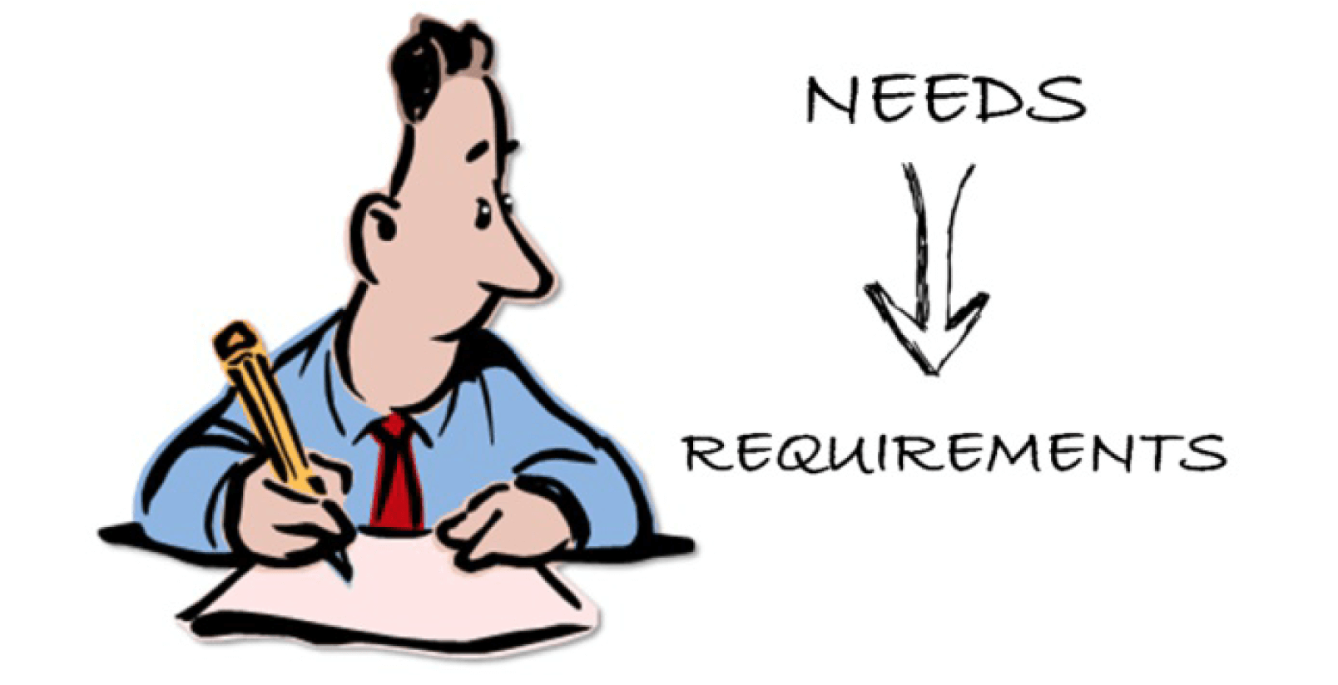
Requirements
A public page with contact information for the company and link to their Facebook page and/or website.
An opening page to show recent recorded estimates after logging in.
Administrator log in (so only authorized users can create estimates) or authorized estimates can be created.
Read all the requirements through text entry boxes and use of drop downs where required.
SaiCharan Gurudu

Slide 13
Requirements
An easy way to create a new estimate, either by starting with the default values or by copying from an existing estimate.
While creating a new estimate, show the job cost in dollars and $/sqft.
Use of symbols like ‘+’, copy estimate, 🗑️, ✎ .
Work saved after every modification, no need to worry about clicking save after every entry.
SaiCharan Gurudu

Slide 14
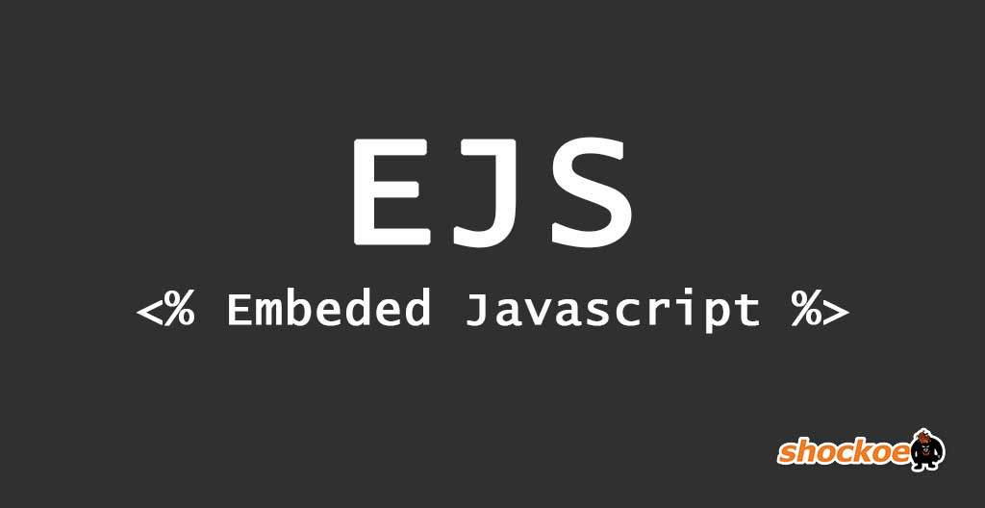









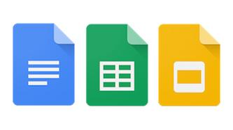


Tools and Technologies
Front-End | EJS, Bootstrap 4, CSS 3
Back-End | Node JS
DataBase Technologies | Mongodb, MySQL
File Management (Cloud Repo) | Git Version Control System
IDE for development | Visual Studio Code
Testing Tool | Selenium
Mail service for App | Mailgun
Integration Tool | Heroku Auto Deployment
Temporary App development | Local Host
Communication (Internal & External) | Email, Slack, Facebook, Google Docs
Yashwanth Reddy
Notes:
SELENIUM :
JAVASCRIPT based is an open source web testing tool
MAILGUN

Slide 15


Tools and Technologies (Adonis)
Sai Ram Vankina

Slide 16
Adonis
Express
DEMO
Vijay Kumar Tupakula
Santosh Sekhar

Slide 17
What we have done - Adonis team
Login page for admin.
Created models and sample data separately for all the Users, Estimates, materials.
Able to view previously created estimates as a list using pagination once logged in.
Create, View, Edit, Delete estimates.
Validating the Inputs for login details and materials.
Exception handling when unauthenticated user trying to access.
Deployed the app.
Sai Ram Vankina

Slide 18
Tasks yet to be done (Adonis)
User Acceptance testing
Documentation
Sai Ram Vankina

Slide 19
What we have done - Express team
A public page with contact information of the company.
Admin Login/Logout functionality.
Able to view previously created estimates
Admin receives an email regarding data entered through contact form
Delete estimates(Admin)
Create estimates(Admin)
Edit estimates(Admin)
Girish Guntuku

Slide 20
Tasks yet to be done (Express)
Final Project documentation
Project testing
Acceptance Testing by client.
Yashwanth Reddy Bommineni

Slide 21
Approach for GDP 2
Use GitHub issue tracker for notifying an issues and assign tasks among team members.
3 Class meetings to discuss progress
Mondays: Assign tasks for the week
Wednesdays: Discuss any issues encountered while working or any changes to me made
Fridays: Fixed issues and check deployment
Methodology: Agile
* one meeting day a month may be for client reviews and feedback.
Yashwanth Reddy

Slide 22
Lessons learnt
We learnt a new technology and implemented that in our project.
The effectiveness of issue handling is improved.
We understood our skill gaps and were able to get through them.
Team collaboration and team working skills.
Sai Sirisha Devineni

Slide 23
Thank you

